Slide 1

ECE 603 Probability and Random Processes
Lesson 17
Chapter 7
Limit Theorems and Convergence of Random Variables
Notes:
Now: Slides with Annotation
Next: Slides with Annotation
*****Preparation Notes*****
Students taking this course should already have covered linear algebra elsewhere.
We will use linear algebra extensively in this course.

Slide 2
Objectives
Examine the use of Law of Large Numbers (LLN).
Examine the use of Central Limit Theorem (CLT).
© 2020 UMass Amherst Global. All rights reserved.
Notes:
Now: Slides with Annotation
Next: Slides with Annotation

Slide 3
Rationale
This lesson will focus on limit theorems and convergence modes for random variables. Limit theorems are among the most fundamental results in probability theory.
You will explore how these theorems are applied in practice.
© 2020 UMass Amherst Global. All rights reserved.
Notes:
Now: Slides with Annotation
Next: Slides with Annotation

Slide 4
Prior Learning
Basic Concepts
Counting Methods
Random Variables
Access to the online textbook: https://www.probabilitycourse.com/
© 2020 UMass Amherst Global. All rights reserved.
Notes:
Now: Slides with Annotation
Next: Slides with Annotation

Slide 5
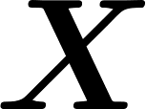
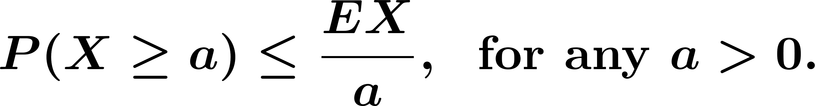
Summary of Probability Bounds
Markov's Inequality
If is any nonnegative random variable, then
© 2020 UMass Amherst Global. All rights reserved.
Notes:
Now: Slides with Annotation
Next: Slides with Annotation

Slide 6

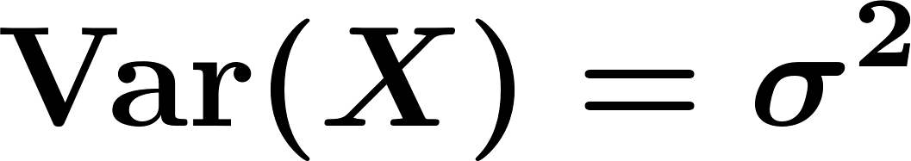
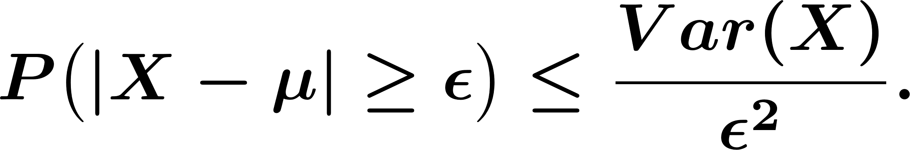

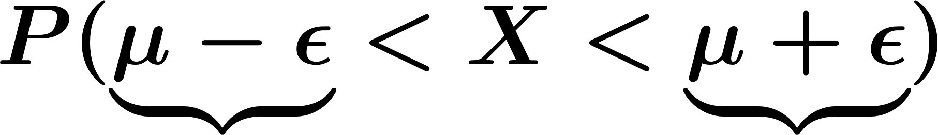


Summary of Probability Bounds
Chebyshev's Inequality
For any random variable , with and , we have
© 2020 UMass Amherst Global. All rights reserved.
Notes:
Now: Slides with Annotation
Next: Slides with Annotation

Slide 7
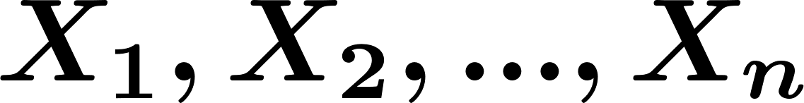

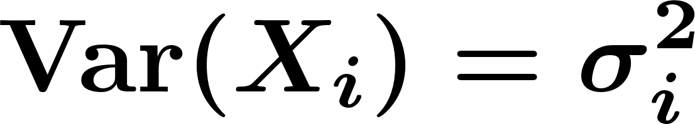
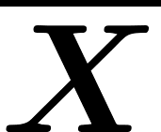
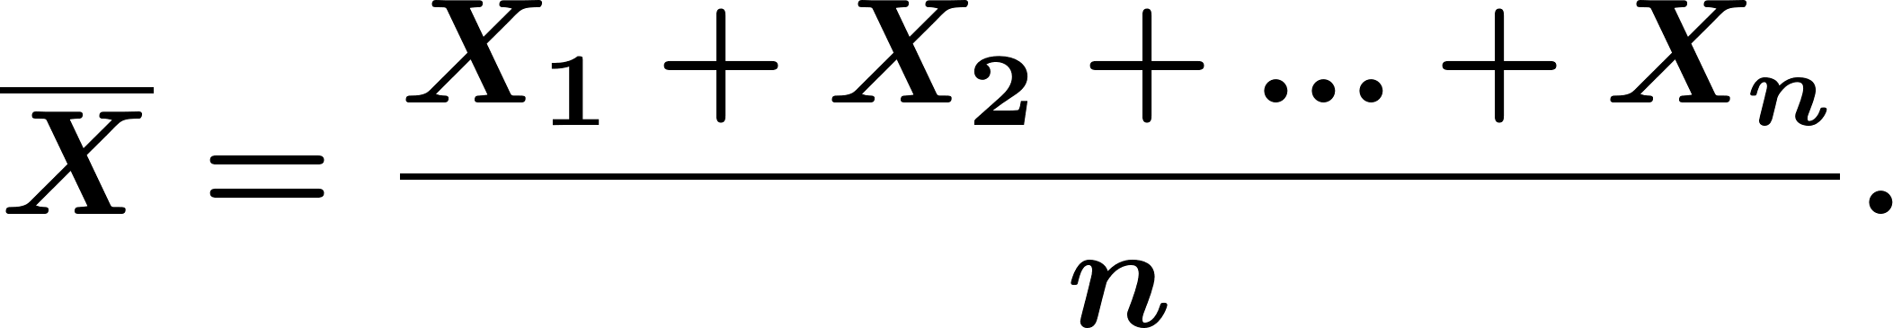
Law of Large Numbers
Definition. For i.i.d. random variables with
and , the sample mean, denoted by , is defined as
© 2020 UMass Amherst Global. All rights reserved.
Notes:
Now: Slides with Annotation
Next: Slides with Annotation

Slide 8
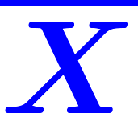
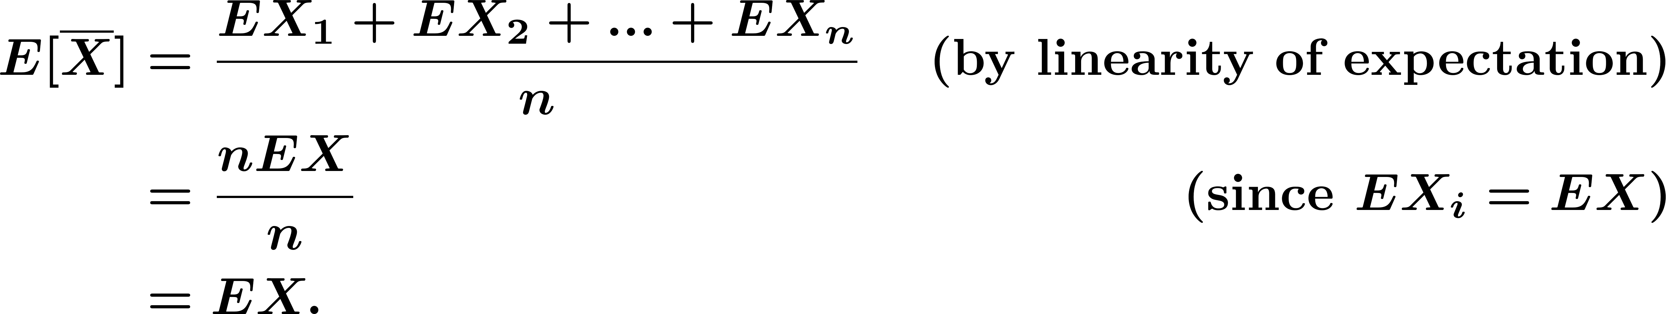
Law of Large Numbers
The sample mean, , is also a random variable, then we have
© 2020 UMass Amherst Global. All rights reserved.
Notes:
Now: Slides with Annotation
Next: Slides with Annotation

Slide 9
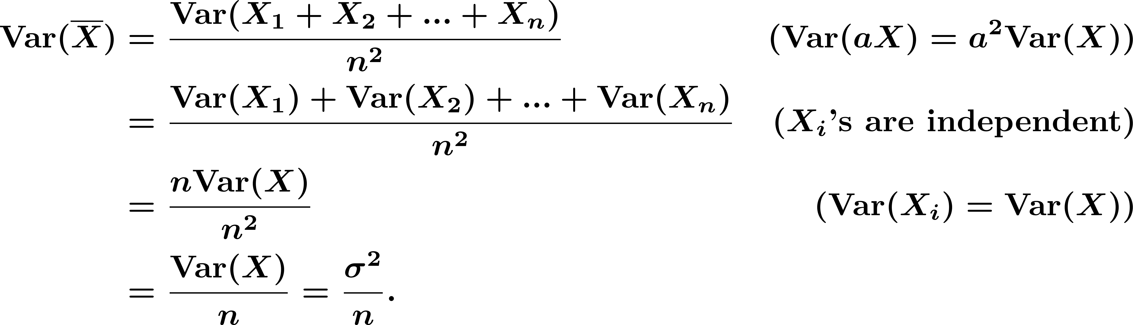
Law of Large Numbers
The variance of is given by
© 2020 UMass Amherst Global. All rights reserved.
Notes:
Now: Slides with Annotation
Next: Slides with Annotation

Slide 10

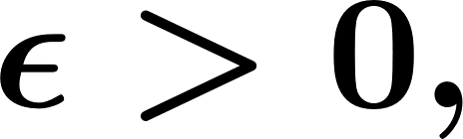
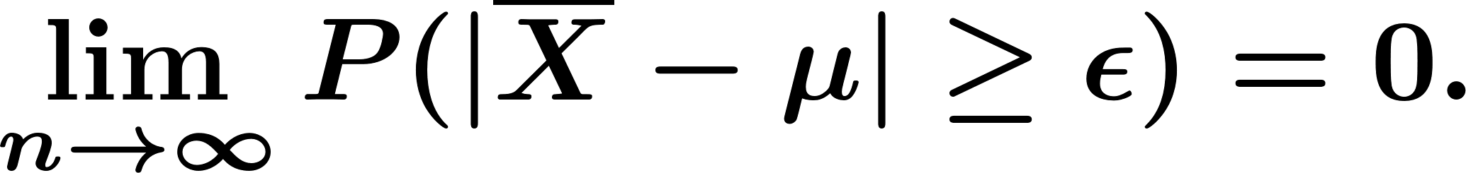
Law of Large Numbers
The weak law of large numbers (WLLN)
Let be i.i.d. random variables with a finite expected value
Then, for any
© 2020 UMass Amherst Global. All rights reserved.
Notes:
Now: Slides with Annotation
Next: Slides with Annotation

Slide 11
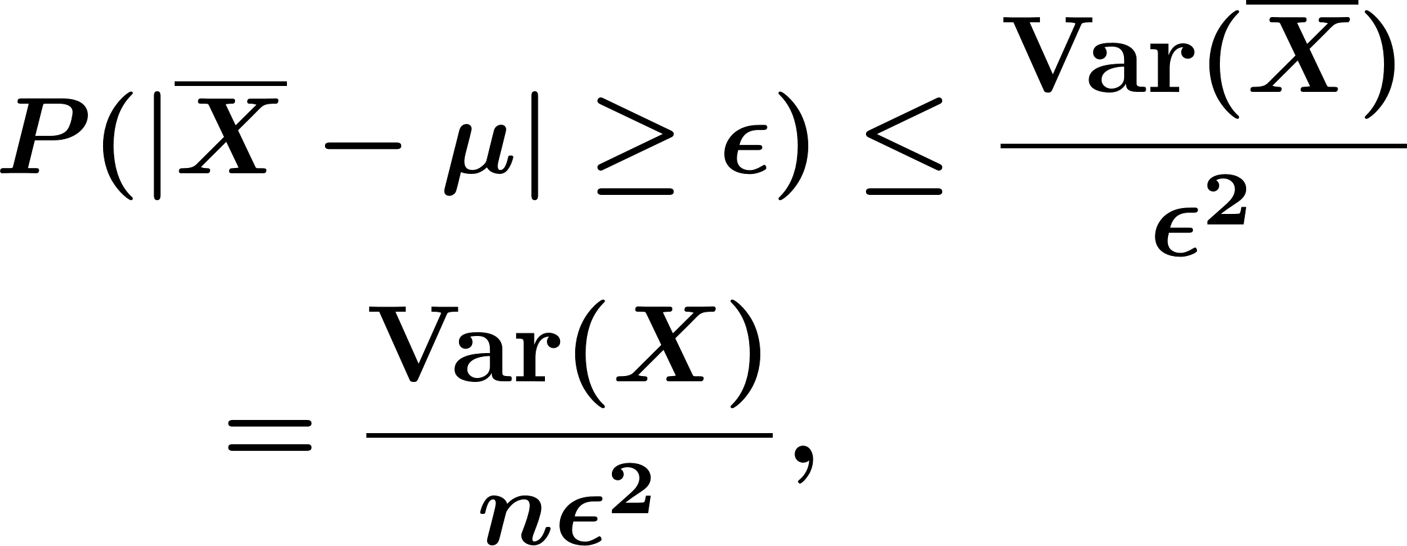

Law of Large Numbers
Proof:
We assume is finite. In this case we can use Chebyshev's inequality to write
which goes to zero as
© 2020 UMass Amherst Global. All rights reserved.
Notes:
Now: Slides with Annotation
Next: Slides with Annotation

Slide 12
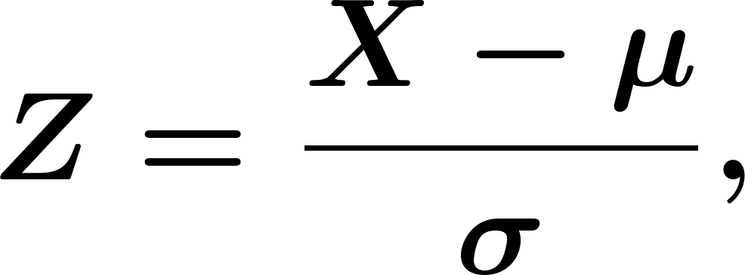
Central Limit Theorem
Note:
if and the normalized random variable is defined:
then,
© 2020 UMass Amherst Global. All rights reserved.
Notes:
Now: Slides with Annotation
Next: Slides with Annotation

Slide 13
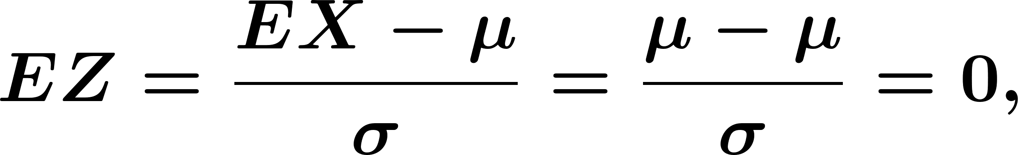
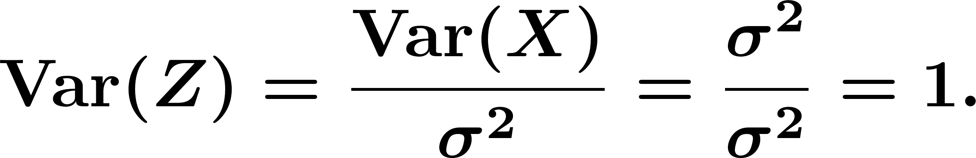
Central Limit Theorem
Proof:
© 2020 UMass Amherst Global. All rights reserved.
Notes:
Now: Slides with Annotation
Next: Slides with Annotation

Slide 14

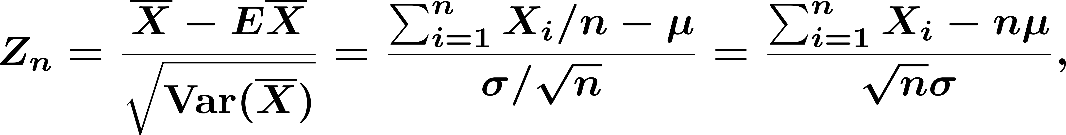
Central Limit Theorem
The Central Limit Theorem (CLT)
Let be i.i.d. random variables with expected value
and variance Then,
© 2020 UMass Amherst Global. All rights reserved.
Notes:
Now: Slides with Annotation
Next: Slides with Annotation

Slide 15

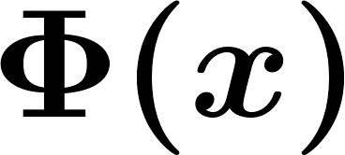
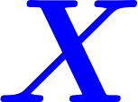
Central Limit Theorem
Converges in distribution to the standard normal random variable as goes to infinity, that is
Where is the standard normal CDF.
Note: This true regardless of the distribution of .
© 2020 UMass Amherst Global. All rights reserved.
Notes:
Now: Slides with Annotation
Next: Slides with Annotation

Slide 16
Central Limit Theorem
Example. Let and
© 2020 UMass Amherst Global. All rights reserved.
Notes:
Now: Slides with Annotation
Next: Slides with Annotation

Slide 17
Central Limit Theorem
In practice finite, but we still can approximate by a Normal random variable.
© 2020 UMass Amherst Global. All rights reserved.
Notes:
Now: Slides with Annotation
Next: Slides with Annotation

Slide 18
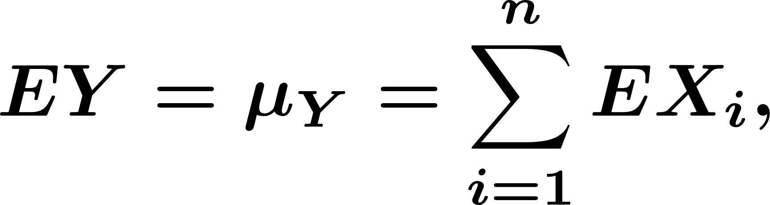
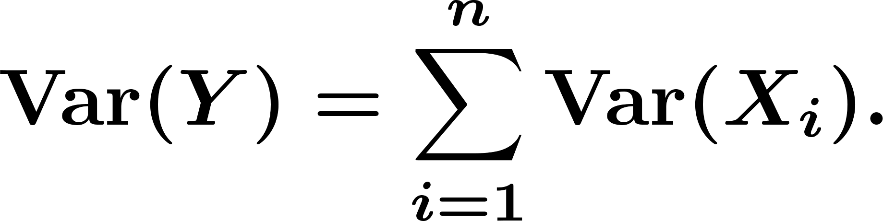

Central Limit Theorem
Two steps to solve problems using CLT:
Find and
Use , so we can use function.
© 2020 UMass Amherst Global. All rights reserved.
Notes:
Now: Slides with Annotation
Next: Orchestrated Conversation

Slide 19
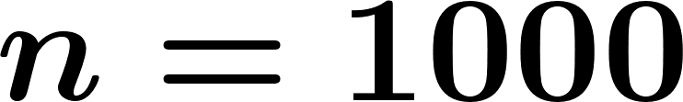
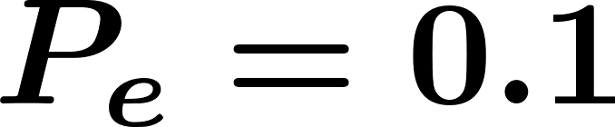
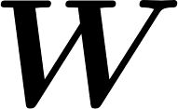
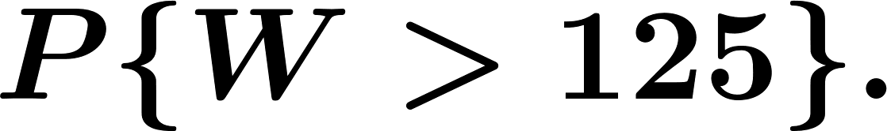
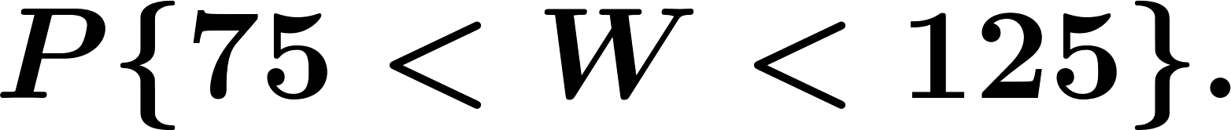
Orchestrated Conversation: Central Limit Theorem
Example.
In a digital communication system bits are transmitted over a wireless channel. Each bit will be received in error with probability (error probability) independently from other bits. Let be the number of error.
Find
Find
© 2020 UMass Amherst Global. All rights reserved.
Notes:
Now: Orchestrated Conversation
Next: Slides with Annotation

Slide 20
Central Limit Theorem
© 2020 UMass Amherst Global. All rights reserved.
Notes:
Now: Slides with Annotation
Next: Orchestrated Conversation

Slide 21
Orchestrated Conversation: Central Limit Theorem
Example.
A multiple choice test has 100 questions, each with four alternative. At least 80 correct answers are required for a passing grand. On each question, you know the correct answer with probability 0.75, otherwise you guess at random. There is no penalty for wrong answers.
© 2020 UMass Amherst Global. All rights reserved.
Notes:
Now: Orchestrated Conversation
Next: Slides with Annotation

Slide 22
Post-work for Lesson
Complete homework assignment for Lesson 17:
HW#9
Go to the online classroom for details.
© 2020 UMass Amherst Global. All rights reserved.
Notes:
Now: Slides with Annotation
Next: Slides with Annotation

Slide 23
To Prepare for the Next Lesson
Read Chapter 10 in your online textbook:
https://www.probabilitycourse.com/chapter10/10_1_0_basic_concepts.php
Complete the Pre-work for Lessons 18-20.
Visit the online classroom for details.
© 2020 UMass Amherst Global. All rights reserved.
Notes:
Now: Slides with Annotation

